Slide 1

Getting started on outcome measurement
SIMNA WA
16 October 2019

Slide 2
What is outcome measurement?
Outcome measurement is a systematic way to assess the extent to which a program has achieved its intended results.
The main questions addressed in outcome measurement are*:
What has changed as a result of this program?
Has this program made a difference?
How are the lives of (people, communities) better?
National Resource Centre, 2010, Measuring Outcomes, Avail. http://www.hfoc.org/uploads/3/8/0/7/38072897/measuringoutcomes.pdf

Slide 3




What is outcome measurement?
Outcome Measurement: assessing the results of a program
Evaluation: assessing quality, merit, or worth (of a program, process)
Research: discovering and creating new knowledge
Notes:
all three can be used alone or to add value to the other – that they have distinct elements that serve specific purposes (research and learning, evaluation and proving and measurement and improving) but together create a strong evidence and decision making basis.

Slide 4
What is outcome measurement?
‘So what?!’

Slide 5
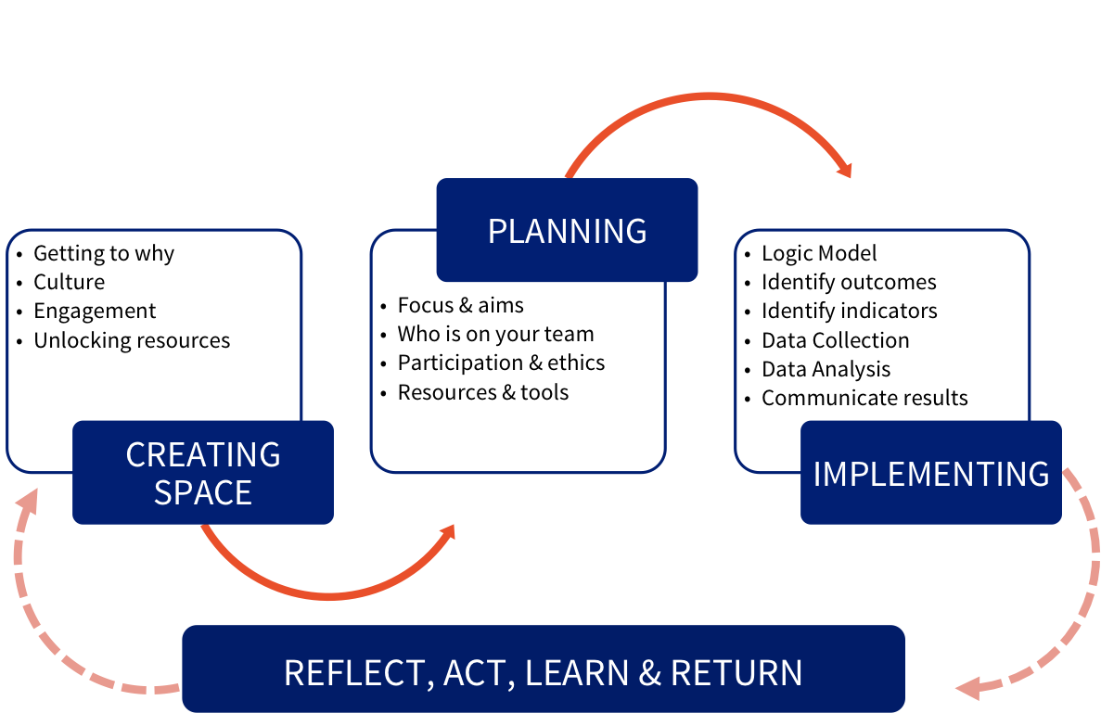
Outcome measurement pathway

Slide 6
Activity - Getting started
You walk into an organisation with a thriving outcome measurement culture and practice:
What does it look like?
What does it feel like?
What does it sound like?
What can you touch?
Who is there?

Slide 7
What does it look like?
People at the centre
Linking mission/vision to data to personal stories
Regular meetings between staff at all levels about how feedback has been sought and used (eg, What’s Working/What’s Not Working/What to do differently?)
Charts on the wall – demonstrating results
Posters of indicators
Post-it notes
Colourful - engaging
Numbers and information
Can see all of this in central/public areas
Marketing material that shows the human side – meaning for people (clients)
Learning from findings
Vision, Mission, Values on the wall in prominent place

Slide 8
What does it Sound like?
Leadership actively listening to staff
WHY? What was different this time
Enquiring - questioning of why data is the way it is is and what actions can be taken to move it in desired directions
people challenging one another - ‘But do we know that?’ ‘What are our assumptions?’ ‘Are our assumptions right?’
Talking about the links between practice and outcomes
Understanding the WHY / HOW / WHAT
Success being celebrated!
Safe and robust conversations
Connecting practice and outcomes
Team meetings – share feedback on outcomes and participant progress
Common language is used - shared language developed
People challenging one another – especially around assumptions
Less of “But we’ve always done it this way”
Good OM needs to include conversations about how to manage upward AND downward accountability to stakeholder needs

Slide 9
What does it feel like?
Safe (as will encounter personal defensiveness/insecurity - safe organisations where toxicity is addressed are so important)
Change is expected
Challenging and questioning
Water-cooler conversations – spontaneous, routine, normalised
Energised, curious, vibrant
Enthusiasm from staff about outcome measurement
Frustrating (change process, funding dis/connect, process/relationship lost)
Uncertainty
scary - it’s scary to question your/other’s assumptions
Inclusive
Adaptive learning

Slide 10
who is there?
EVERYONE!
Clients, service users, beneficiaries
Community
Practitioners/workers
Leadership (including CEO) = promoting the value of the work = resourcing
Funders
Board (perhaps a sub-committee focussed on service development)
All levels of staff – admin to CEO
Professional specialists
Diverse range of voices
Other service providers
external collaborators and partners - other research institutions, universities, other researchers

Slide 11
what can you touch?
Reports
Minutes of meetings where it’s on the agenda and been discussed
Strategic plan – processes built in

Slide 12
Activity – self assessment
Building Capacity
Sharing Learning
Leadership
Organisational Culture

Slide 13
RESOURCES
Australian Institute of Family Studies – some great resources on culture, getting started, strategy, tools, ethics (not just for work with families) https://aifs.gov.au/search/site/evaluation
Centre for Social Impact UWA Outcome Measurement Course (f2f in WA in Oct, online in Nov) https://www.csi.edu.au/news/outcomes-measurement-workshops-details/
CSI ‘The Compass: Your Guide to Social Impact Measurement’ avail. https://www.csi.edu.au/research/project/compass-your-guide-social-impact-measurement/
New link - National Resource Centre, 2010, Measuring Outcomes, Avail. http://www.hfoc.org/uploads/3/8/0/7/38072897/measuringoutcomes.pdf

Slide 14
CLOSE and thankyou

